Slide 1
Anti-Racist Outcomes & Assessments
Chipo C. Nyambuya, Esq., School of Law
Jeffery Huntsinger, Department of Psychology
Focus on Teaching and Learning, Spring 2021
Developing Pedagogy that Fosters Anti-Racism

Slide 2
How and Why to Create Anti-Racist Learning Outcomes
Anti-racist Pedagogy and Learning Outcomes
Chipo C. Nyambuya, Esq.
Law School

Slide 3
Laying the Foundation: Towards Anti-racist Pedagogy
What does this work require?
What questions should you ask yourself?
What are you trying to assess?
What determines the value in what you are trying to assess?
Notes:
Error pushes scores higher or lower, and with more assessments errors in different directions cancel themselves out. Student may have a good day and score high on first exam, and the same student may have a bad day and score low on next exam.
Bias is a systematic error in the measurement process that differentially influences scores for certain groups.
In other words, the test is measuring something different across groups. You get less true score in the presence of bias in certain groups.

Slide 4
Identity and Values: Towards Anti-racist pedagogy
Being cognizant and awake to who you are as an individual and as a teacher/educator
Who we are and how we see the world helps us in developing our strengths and evolving past our shortcomings and become more “whole” and holistic humans and educators
What biases are in your delivery of the educational information (i.e. vocabulary? cultural social references?)
Notes:
Error pushes scores higher or lower, and with more assessments errors in different directions cancel themselves out. Student may have a good day and score high on first exam, and the same student may have a bad day and score low on next exam.
Bias is a systematic error in the measurement process that differentially influences scores for certain groups.
In other words, the test is measuring something different across groups. You get less true score in the presence of bias in certain groups.

Slide 5
Goal Setting: Towards Anti-racist Pedagogy
Revisit the goal(s)/desired learning outcomes of the course
why you set certain objectives (i.e. to understand particular information
develop particular skills;
foundational laying for particular skills?
Why is this goal/objective important to ALL of your students
What deficiencies are you assuming?
What strengths are you ignoring?
Revisit your biases; what biases did/do you have as part of your goal setting to assess?
How did/might your biases have informed your course’s goals/objectives setting (i.e. what is important and why? What have you dismissed as important? why)
Notes:
Error pushes scores higher or lower, and with more assessments errors in different directions cancel themselves out. Student may have a good day and score high on first exam, and the same student may have a bad day and score low on next exam.
Bias is a systematic error in the measurement process that differentially influences scores for certain groups.
In other words, the test is measuring something different across groups. You get less true score in the presence of bias in certain groups.

Slide 6
Maintaining Goal Setting and Assessements: Towards Anti-racist Pedagogy
How can we keep doing this every year?
Self care (diet, exercise, meditation, etc.)
Keep talking to your colleagues; pedagogical teams
In the law school we Participate in Mindfulness Pop-ups and Community Building Circles
Attend diversity, inclusion, and equity-related events
Continue to educate yourself on related topics
Participate in and with student groups on related topics (this is where the vulnerability is particularly important because you may have to acknowledge and respect your ignorance about how to deliver something you’re highly skilled and trained to do)
Notes:
Error pushes scores higher or lower, and with more assessments errors in different directions cancel themselves out. Student may have a good day and score high on first exam, and the same student may have a bad day and score low on next exam.
Bias is a systematic error in the measurement process that differentially influences scores for certain groups.
In other words, the test is measuring something different across groups. You get less true score in the presence of bias in certain groups.

Slide 7
Maintaining Goal Setting and Assessements: Towards Anti-racist Pedagogy, cont’d
How can we keep doing this every year?
As you may be aware, people of color experience exhaustion and frustration of constantly having to educate those with different lived experiences
To grow in self-awareness, self-education is key in order to being able to talk about these issues with others
As individuals we should take responsibility in educating ourselves, rather than to look to someone else, especially people of color, to do so
This particular trait is also a great aspect of a good friend, colleague, ally, co-conspirator
Notes:
Error pushes scores higher or lower, and with more assessments errors in different directions cancel themselves out. Student may have a good day and score high on first exam, and the same student may have a bad day and score low on next exam.
Bias is a systematic error in the measurement process that differentially influences scores for certain groups.
In other words, the test is measuring something different across groups. You get less true score in the presence of bias in certain groups.

Slide 8
Journey: Towards Anti-racist Pedagogy
This is a journey, take it one step at a time
It can be done.
Actively participate in the University’s Racial Examen
"We are not meant to look at America the same way again-- that's the whole point of the Trumpian experience.
We are to lose our narcissism and open our eyes on our shadow side, which, thru Trumpism, clamors to be finally acknowledged. We are not meant to recover but to transform." ~ elizabeth mika
Thank you!
Notes:
Error pushes scores higher or lower, and with more assessments errors in different directions cancel themselves out. Student may have a good day and score high on first exam, and the same student may have a bad day and score low on next exam.
Bias is a systematic error in the measurement process that differentially influences scores for certain groups.
In other words, the test is measuring something different across groups. You get less true score in the presence of bias in certain groups.

Slide 9
Bias, Testing, and Assessment: Problems and Solutions
Developing Pedagogy that Fosters Anti-Racism
Dr. Jeffrey R. Huntsinger
Department of Psychology
ocus on Teaching and Learning, Spring 2021

Slide 10
Testing and Assessment: Some Basics
Classical test theory: A person’s observed score on a test is composed of both a true score (e.g., ability) and an error score.
O = T + E
Usually error is random.
The more tests and assessments, the better measure of students’ underlying ability because random error in both directions cancels out.
Notes:
Error pushes scores higher or lower, and with more assessments errors in different directions cancel themselves out.
Student may have a good day and score high on first exam, and the same student may have a bad day and score low on next exam.

Slide 11
Testing and Assessment: Some Basics
Bias, however, is not random.
The presence of bias affects the validity of the test.
Bias systematically pushes scores of one group down, causing disparities in test performance across groups.
Notes:
Bias is a systematic error in the measurement process that differentially influences scores for certain groups.
In other words, the test is measuring something different across groups. You get less true score in the presence of bias in certain groups.

Slide 12
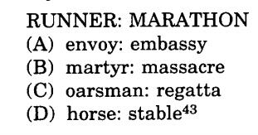
Sources of bias in testing and assessment
Biased test questions
Some questions contain content that is more familiar to one group than another.
Occurs when one assumes common background knowledge across groups that doesn’t exist.
Notes:
Tests are often designed with racial, cultural, and SES bias. Similar to the problems with gender bias, the issue here is that the content of certain questions may be unfamiliar to African American students or students from other cultures/countries. Be careful with assumptions of common background knowledge that may not be true. Such assumptions may make it much more likely that questions contain knowledge that is held by White, middle-class students.
A classic example is the SAT from a few decades ago, that used an analogy with the word “regatta” that few African American students were familiar with at the time, but that White students at the time were.
Mathematical word problems or multiple-choice items that contain material more familiar to men will favor men over women. For example, questions about sports, like baseball or football, that men are more familiar with than women, will cause men’s scores to be higher than women’s scores.
As an example, imagine a word problem, or multiple-choice question, that requires knowing how many strikes equal an out in baseball or how many yards on a football field. This may seem like common background knowledge, but it may not be among all groups.

Slide 13
Sources of bias in testing and assessment
Stereotype Threat
Research shows that when a stereotyped identity, like race or gender, is made salient in the testing environment this may evoke stereotype threat.
Stereotype threat occurs when people fear confirming stereotypes about their social groups.
Anxiety that results from this fear then impairs working memory capacity and undermines test performance.
Notes:
Research shows that when a stereotyped social identity, like race, is made salient in the testing environment this depresses African American’s performance by causing a form of test anxiety.
This anxiety, which results from a fear of confirming the stereotype that African Americans are not good at academics, impairs working memory capacity. This deficit in working memory capacity makes it difficult to perform at one’s best.
Merely having people indicate their gender prior to the exam can cause stereotype threat effects. Testing environment matters as well. African Americans, who take exams as a solo or one of a handful of their group in the testing environment, do worse than African Americans in more balanced testing environments do. In addition, having an African American as the proctor, especially one who appears competent in academics, reduces stereotype threat.
Simply having demographic questions at the beginning of the test may elicit ST.

Slide 14
Sources of bias in testing and assessment
Guessing
Time constraints
Notes:
Guessing: Research shows men are more likely than women to take risks on tests and guess when they do not know the answer. Women tend to answer only if they are sure they are correct. Unwillingness to make educated guesses has a negative impact on scores. This is particularly the case for multiple-choice items, but less so for open-ended questions that do not allow for guessing (just bullshitting, I suppose).
Time constraints: Women are more likely to work a problem out completely, to consider more than one possible answer, and check their work. This is usually a good trait in school, of course. However, when tests are timed this works against women. In this case, women answer fewer questions than men do because they take more time per question. Research shows that when time constraints are lifted, women and men score equally well.

Slide 15
Fixes
Biased test questions
Do not assume equal background knowledge across test takers.
Stereotype threat
Do not highlight, in any way, social group membership during the exam. This includes test questions themselves. No demographics before exam.
Guessing
Have a mix of multiple choice and open-ended questions
Time constraints
If possible, give students plenty of time to take exam, consider no time limit
Take home exams or written assignments

Slide 16
Determining if bias exists
Measurement invariance
In order for tests to be fair and valid, it is essential that tests measure what they are supposed to measure and that individual differences in test scores do not reflect irrelevant characteristics associated with group membership.
This means that test takers of equal ability with respect to the construct the test is meant to measure should on average earn the same test score, regardless of group membership.
Have fellow faculty or graduate students examine tests and assessments before having students complete them. Ask them to check for biased questions, etc.
Notes:
There is evidence that measurement invariance across groups is a problem in cognitive tests, such as the SAT and IQ tests. This means that the same construct is not being measured across groups, and that differences in scores reflect irrelevant characteristics associated with the groups in question (e.g., the group is subject to systemic racial bias, etc.). The test, or items making up the test, are functioning differently across groups. There are also issues of predictive validity, but this is less clear.
You would also want to check for measurement invariance across groups, men vs women, and White vs African American students. Also, look at item-level effects, like differential item function that shows the extent to which an item might be measuring different abilities for members of different groups. There is also item discrimination, which refers to the ability of an item to differentiate among students based on how well they know the material. Ideally, an item will differentiate high and low scoring students. You want this to look the same across groups.
The more eyes the better when looking for bias.

Slide 17
Other considerations
Multiple tests and assessments are better than a single test (e.g., only a final exam).
Having multiple forms of assessment is best—multiple choice items, short and longer answer items, projects and longer written assignments.

Slide 18
Other considerations
One important way to check that a screening test is not biased against African American students, for example, is to look at the association between scores and grades in courses.
The test should show predictive validity. It should predict students’ grades in the course for which it is being used as a screening tool. If it doesn’t that is a problem.

Slide 19
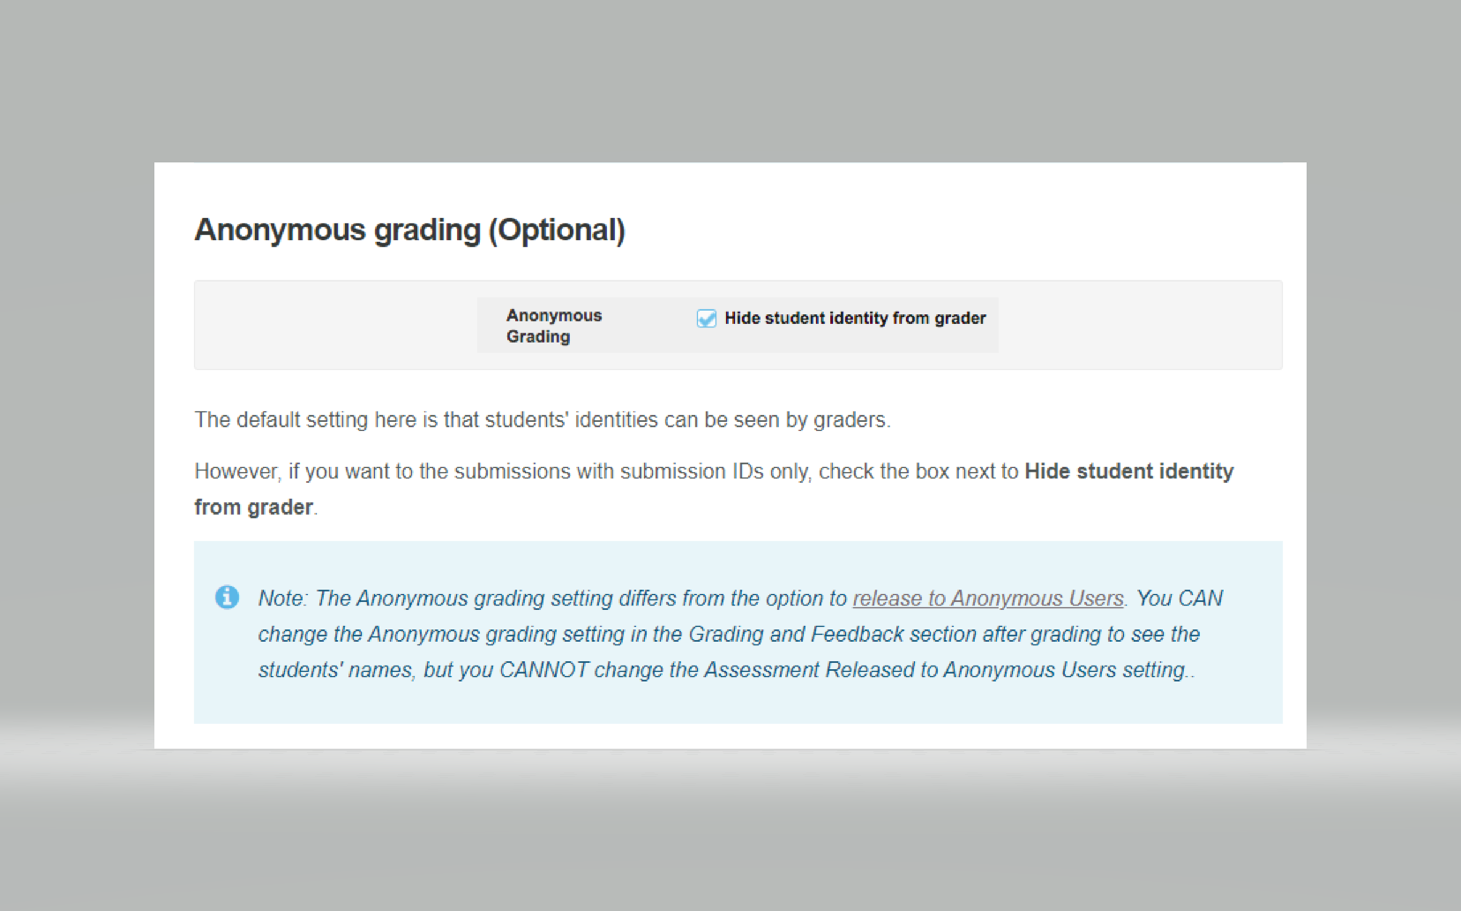
Other considerations
When grading written work, do so without knowing whose work you are grading. This will effectively eliminate your own biases from influencing your grading of students’ work.
http://loyola.screenstepslive.com/s/17190/m/84386/l/1079897-what-are-the-grading-and-feedback-options-for-an-assessment
Notes:
http://loyola.screenstepslive.com/s/17190/m/84386/l/1079897-what-are-the-grading-and-feedback-options-for-an-assessment

Slide 20
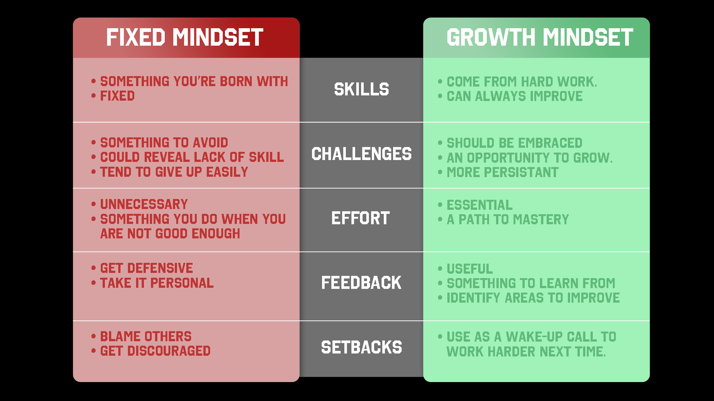
Other Considerations
Classroom environment
Growth versus fixed mindsets
Sense of belonging (especially STEM)
Notes:
Recent research shows that college students’ perceptions of their STEM professors mindset beliefs about fixedness or malleability of intelligence predicts students performance in STEM classes and their interest in STEM more broadly.
Those in classes where professors endorses more fixed mindset beliefs experienced less belonging in class and poorer performance than students in classes where professors held more malleable mindset beliefs about intelligence.

Slide 21
Coda
Creating unbiased tests and assessments is difficult, but quite possible with hard work.
Notes:
In graduate school, I doubt many of us were taught best practices in tests and assessments, like how to create a valid and reliable exam for example.
We often use test banks published with textbooks with unknown validity and reliability or we make up our own questions and exams and we do not interrogate their validity and reliability.

